Slide 1


Wealth Arena
Empowering Beginners to Invest with Confidence
Wealth Arena is a beginner-friendly trading education and simulation app. It helps reduce risk, avoid scams, and provides a gamified learning experience for new traders, students, and financial literacy programs.
Learn, Practice & Master Trading — Without Losing Real Money.

Slide 2
Presentation Overview
01
02
03
Introduction
Presentation Overview
Meet the Team
04
05
06
The Market Opportunity
The problem
Our Solution
07
08
09
System Architecture
Results and Metrics
Vision
10
11
12
Demo & Portfolio
References
Q/A?

Slide 3
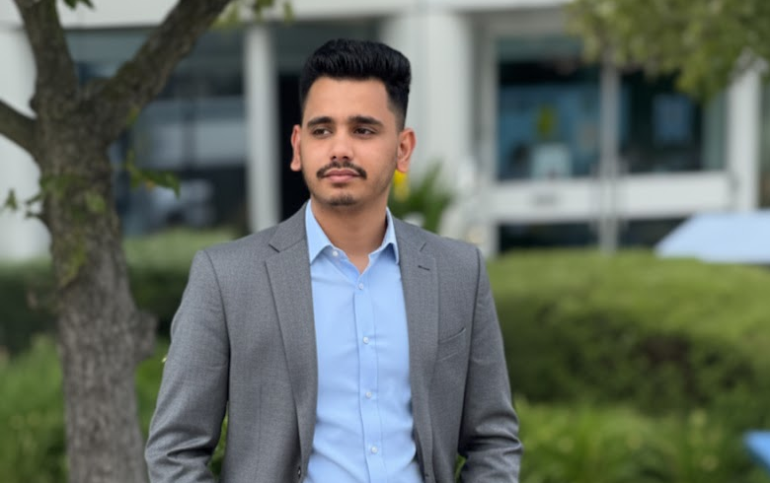
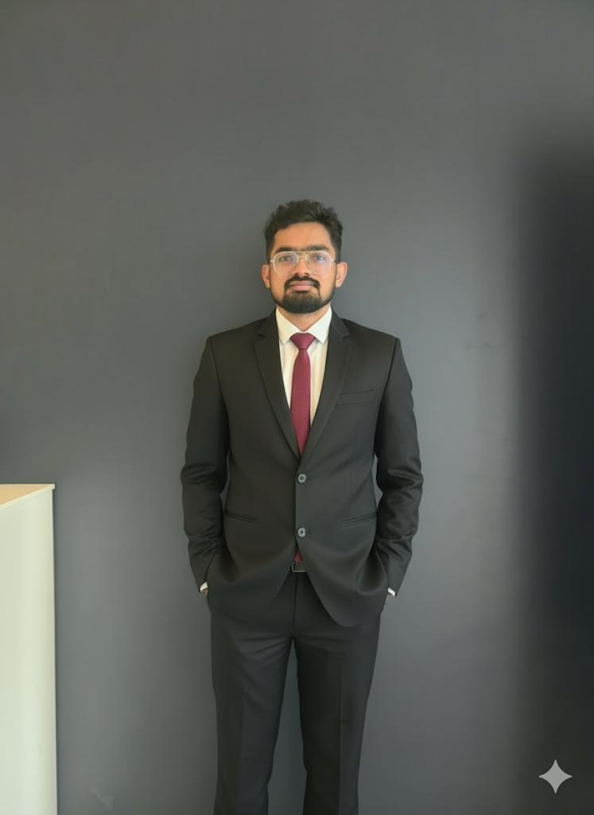
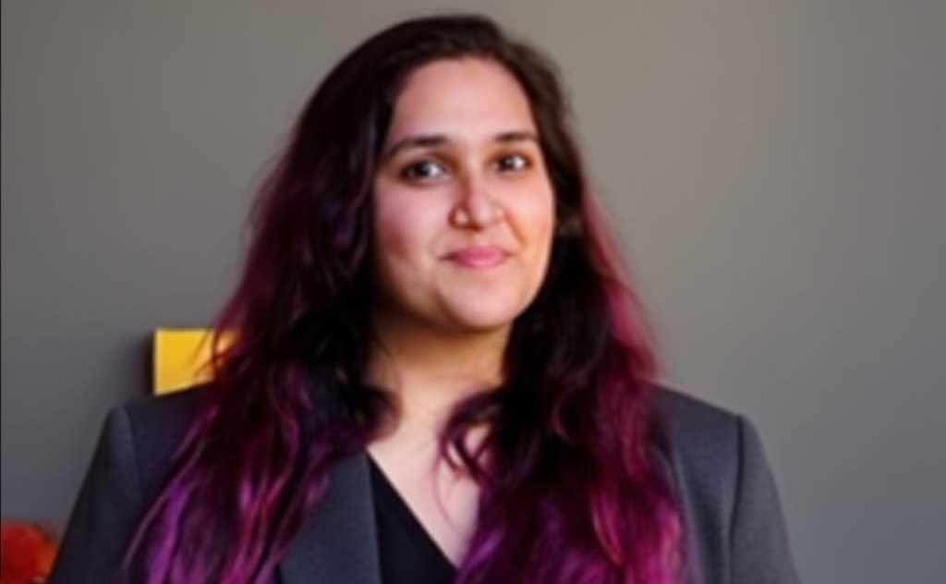
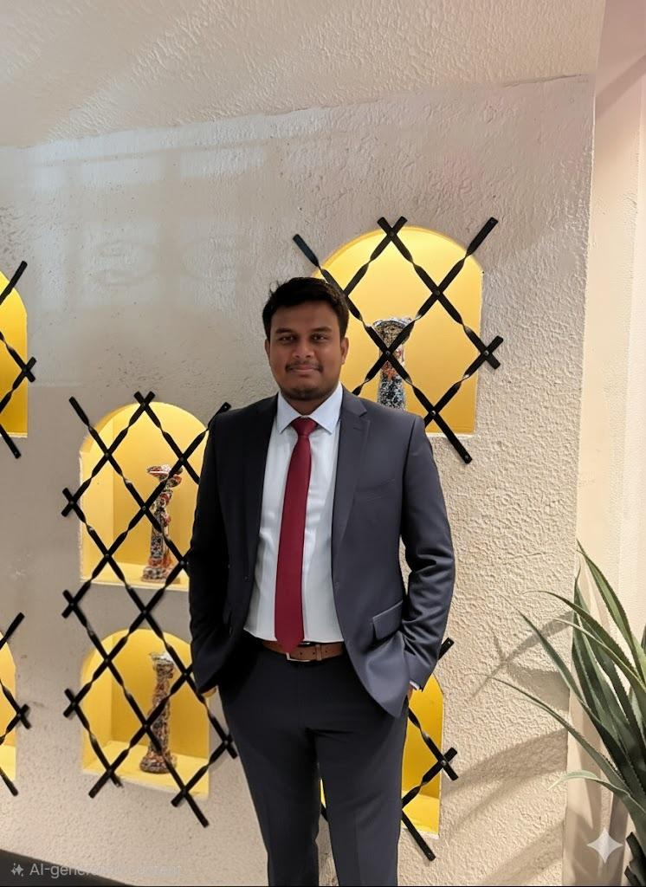
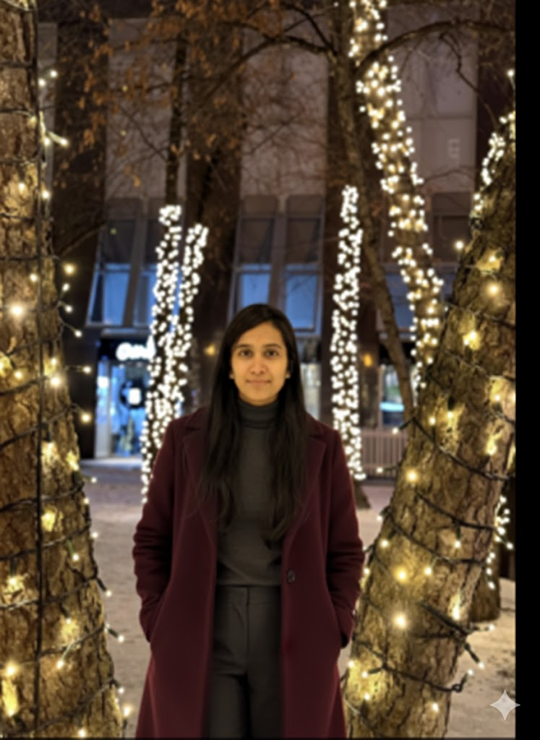
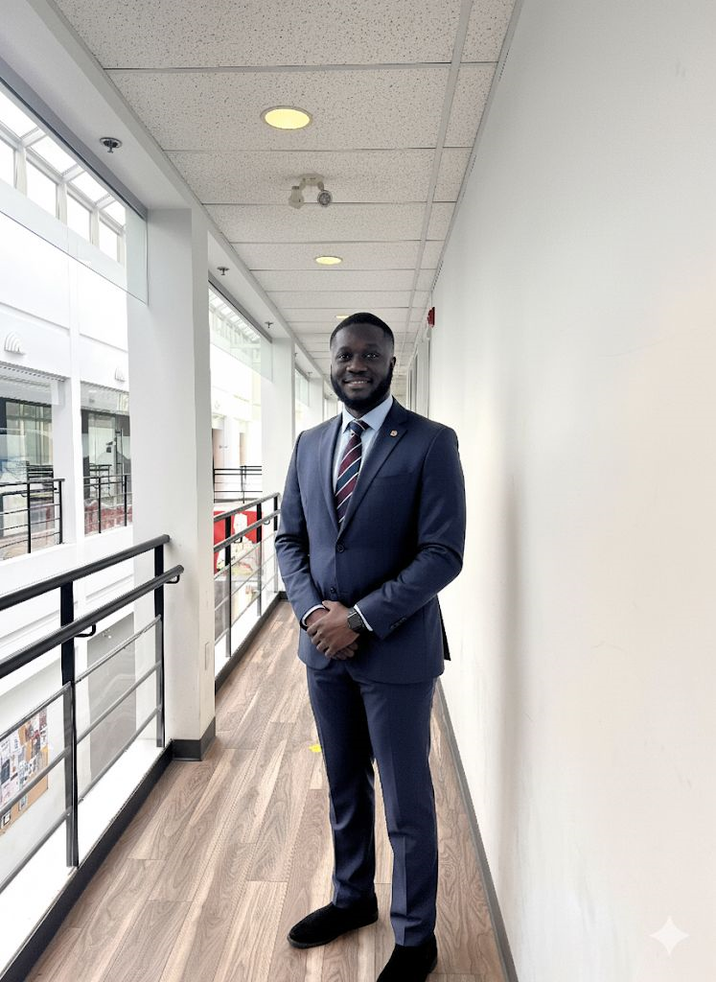

Meet the Team
Shivam Bhargav
Harsha Vardhan Reddy
Kanika
CS Engineer 1
AI Engineer 1
AI Engineer 2
Neha Nareshbhai Patel
Clifford Addison
Amruth Raj
CS Engineer 2
AI Engineer 3
AI Engineer 4

Slide 4

The Market Opportunity
5M+
$ 2.5k per user
65%+
New traders
Trading losses annually
Invest without proper guidance
Join every month in the major markets and platforms
Loss incurred by beginner traders due to lack of education
New traders lack formal financial education or mentorship
* The numbers displayed are approximate numbers calculated from references

Slide 5




The Problem: A Beginner's Minefield
Lack of Tailored Resources
Overwhelming & Misleading Info
Generic information that doesn't match individual learning styles or needs.
YouTube channels and social media provide inconsistent or biased advice.
High Risk, High Scams
Beginners are vulnerable to financial losses and fraudulent schemes due to lack of awareness. 75% of first-time traders quit after early financial loss.

Slide 6




Our Solution: Wealth Arena's Unique Approach
Customized Learning
Educational resources tailored to user profiles and progress.
AI Chatbot Support
Instant, accurate answers to trading questions and concepts.
Gamified Simulation
Reinforcement Learning-powered Game Arena for risk-free practice.
Value Articulation: Learn → Play → Grow
Only app combining :
Financial Education + RL Simulation + AI Chatbot + Personalized Learning

Slide 7
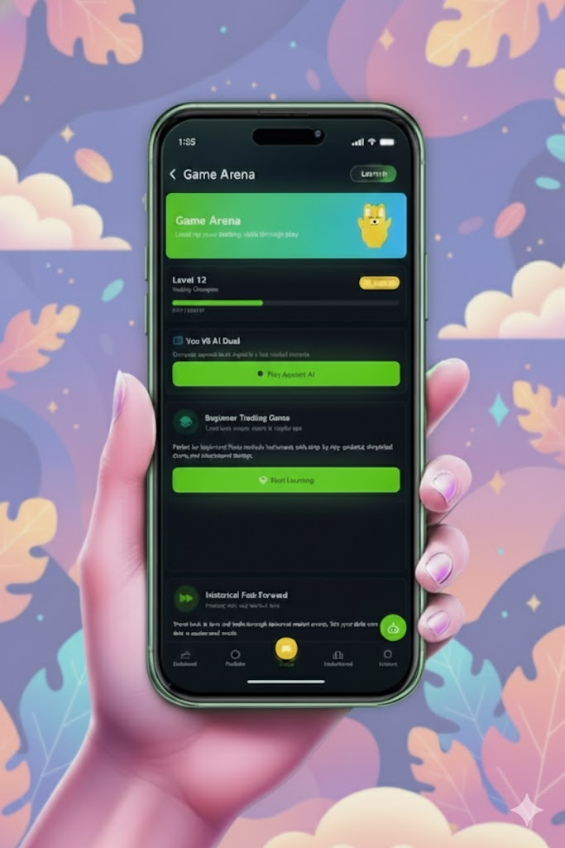
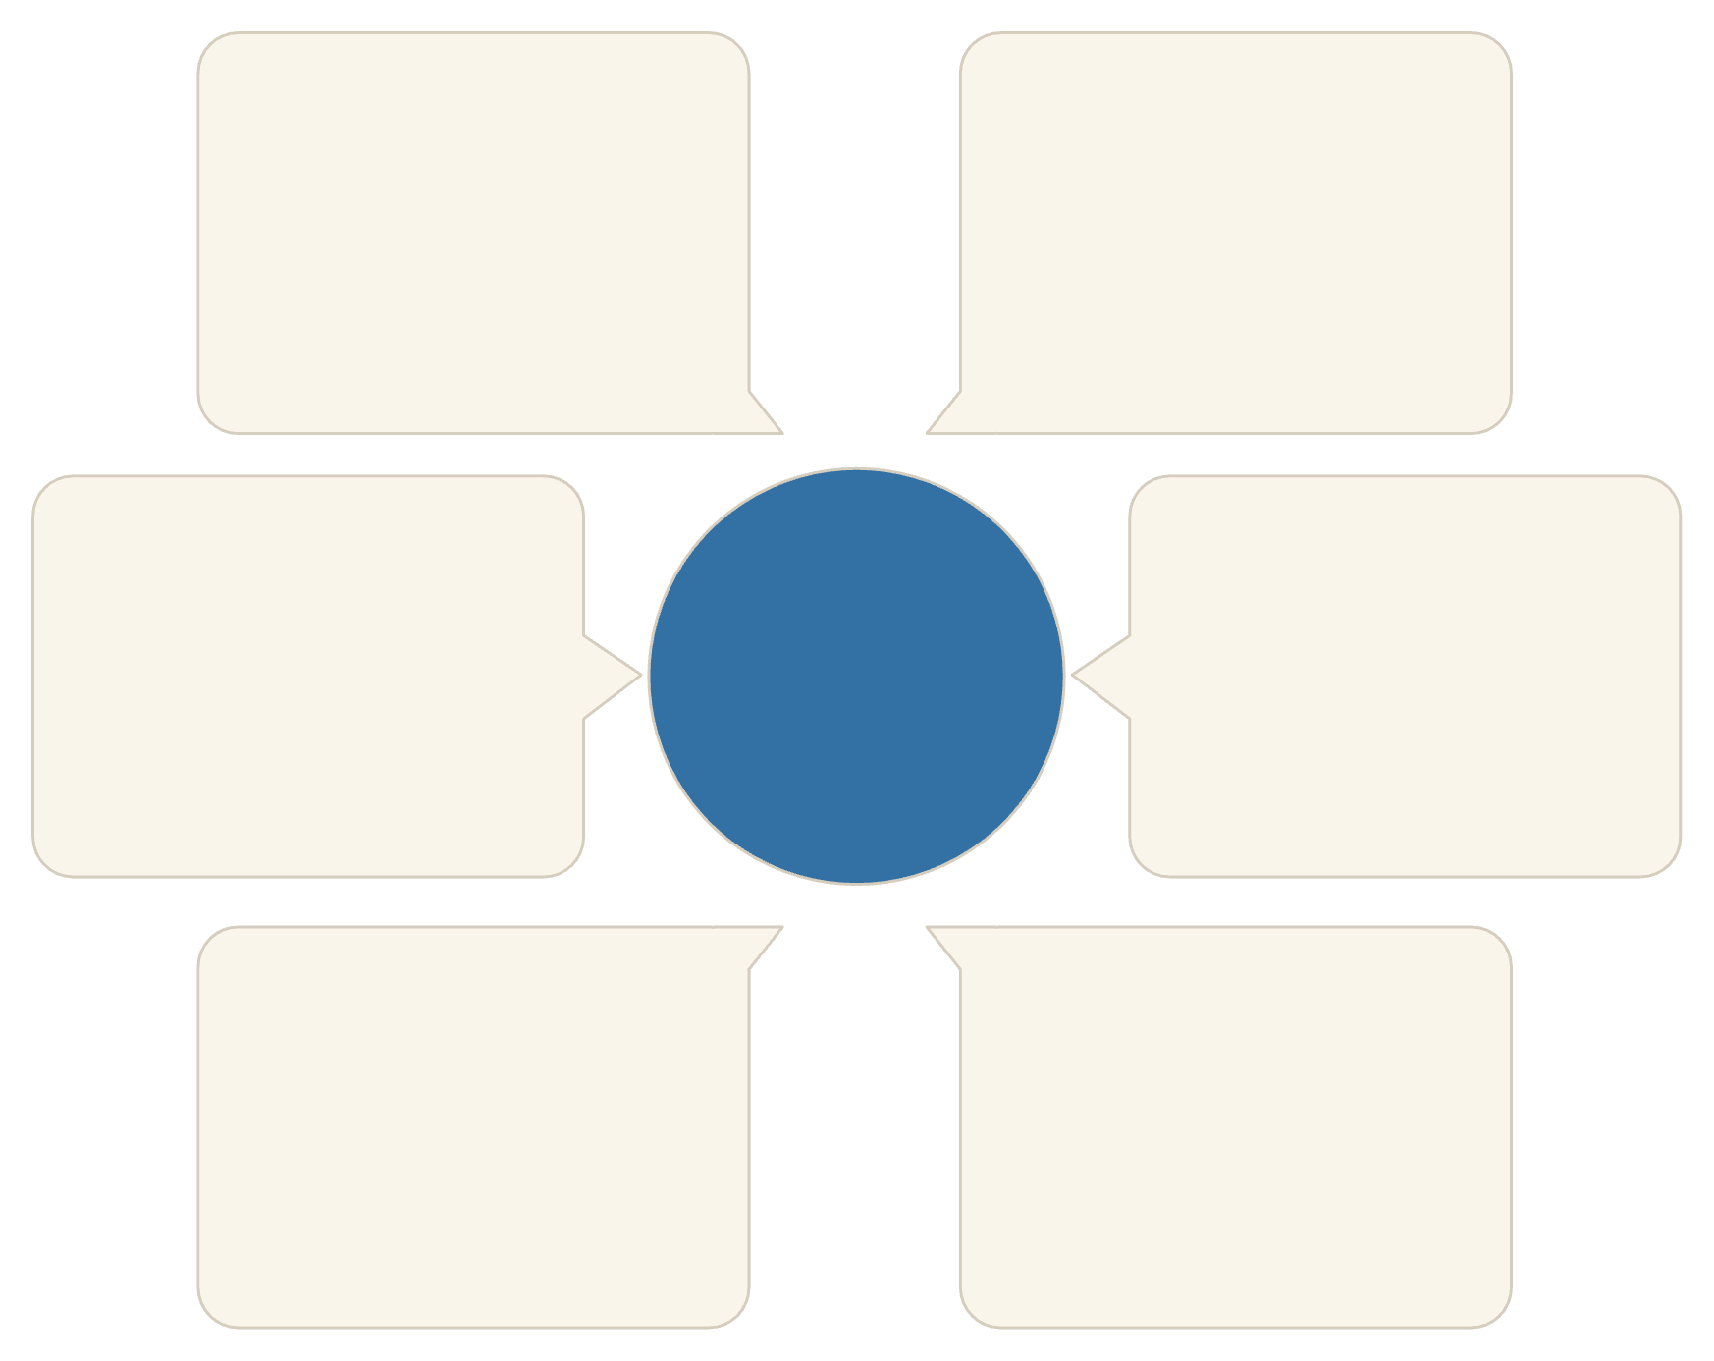
System Architecture
Azure and Airflow
Mobile / Web Apps
Azure App Service | Airflow | Azure Storage
React Native | Web UI | REST
Chatbot Engine
APIs
System Architecture
FastAPI | Llama-3 (Groq) | ChromaDB (RAG)
REST | OpenAPI | JWT Security
RL Model (PPO & SAC)
Backend Services
PyTorch | Stable Baselines3 | PPO/SAC
Python | Background Workers | Prometheus Monitoring
Our robust architecture ensures seamless learning and simulation experiences.

Slide 8




Results & Metrics
App UI & Chatbot
Intuitive dashboard with real-time chatbot
responses. Personalized learning paths in
development.
RL Model
5 RL agents developed for each asset class. Meta-controller optimizes trading decisions with promising early results.
Extensive Codebase
Robust architecture with 404,425 lines
of code across frontend, backend,
and ML components.
Market Coverage
Comprehensive simulation environment covering Stocks, Cryptos, Forex, ETFs, and Commodities with real-time indicators.

Slide 9

Vision for the Future
Our goal is to create a fully functional, gamified trading platform where users can simulate, learn, and confidently invest without real-world risk.
Educational Adoption
User Reach
Becoming the go-to platform for financial literacy.
Empowering millions of new investors globally.
Market Impact
Partner with FinTech
Fostering a generation of confident, informed traders.
Launch trading option in-app.

Slide 10
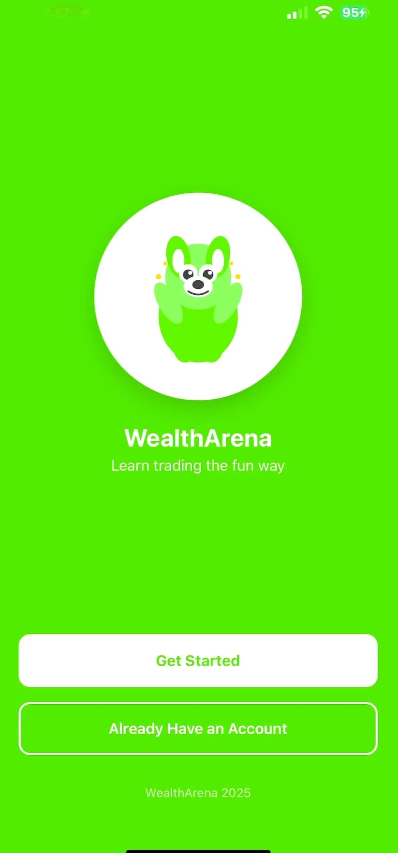
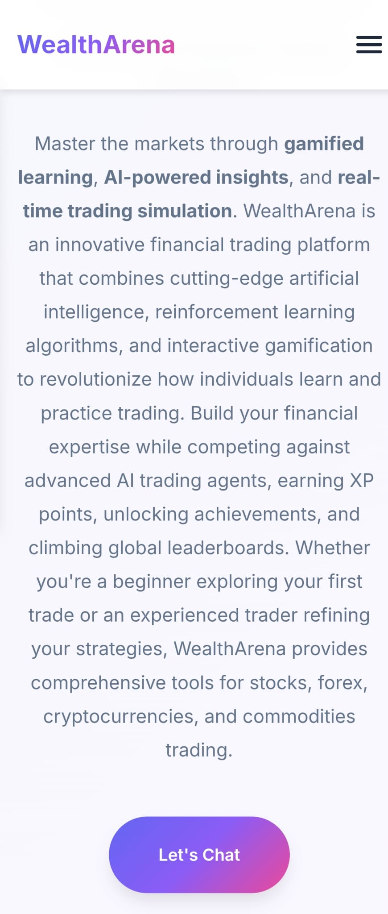
Demo and Portfolio
Link to the Demo:
Link to the Portfolio:
https://drive.google.com/file/d/1C1iS5n6GWbKJst5z1Xt0rRowNH5wa_s1/view?usp=sharing
WealthArena - A New Era of Financial Trading

Slide 11
References
BlackRock. (2025, May 12). Response to IOSCO’s consultation report on neo-brokers [Letter]. BlackRock.
https://www.blackrock.com/corporate/literature/publication/iosco-consultation-report-on-neo-brokers-120525.pdf
Sethuraman, S. (2025, January 8). Demat tally surges to 185 million in 2024 with 46 million new additions. Business Standard.
https://www.business-standard.com/markets/news/demat-tally-surges-to-185-million-in-2024-with-46-million-new-additions-125010800853_1.html
Acuiti. (2024). Retail revolution: How retail brokers in Europe are planning to counter CFD restrictions and what that means for institutional markets [Report]. Acuiti.
https://www.acuiti.io/wp-content/uploads/2024/03/Retail-Revolution-in-Europe.pdf
Standard & Poor’s Ratings Services. (2015, November 18). Two-thirds of adults worldwide are not financially literate and significant gender gap exists, finds global study [Press release]. S&P Global.
https://press.spglobal.com/2015-11-18-Two-Thirds-of-Adults-Worldwide-Are-Not-Financially-Literate-and-Significant-Gender-Gap-Exists-Finds-Global-Study
Organisation for Economic Co-operation and Development. (2023). OECD/INFE 2023 international survey of adult financial literacy [Report]. OECD Publishing.
https://www.oecd.org/content/dam/oecd/en/publications/reports/2023/12/oecd-infe-2023-international-survey-of-adult-financial-literacy_8ce94e2c/56003a32-en.pdf
Agarwal, A. (2025, July 7). Indian retail investor losses on derivative trades widened in 2024–25, regulator says. Reuters.
https://www.reuters.com/sustainability/boards-policy-regulation/indian-retail-investor-losses-derivative-trades-widened-2024-25-regulator-says-2025-07-07/

Slide 12

Questions?
Thank you for your time and consideration.
We are now ready to get grilled! ♨️

